Slide 1


Slide 2

Credit Card Fraud Detection
By
_____________
Nigar Tasmim Ahamed

Slide 3
The Problem
The Credit Card Fraud Detection Problem involves analyzing historical credit card transactions to identify those that were fraudulent. This analysis helps create a model that can predict whether new transactions are fraudulent. Our goal is to accurately detect fraudulent transactions while minimizing false fraud classifications.

Slide 4



Data Description
Imbalance: Frauds are 0.172% of all transactions
Numerical Data: PCA transformed features (V1 to V28)
Exceptions: 'Time' and 'Amount' are not PCA transformed
Time: Seconds elapsed since first transaction
Amount: Transaction value, useful for cost-sensitive learning
Response Variable: 'Class' (1 = fraud, 0 = non-fraud)

Slide 5
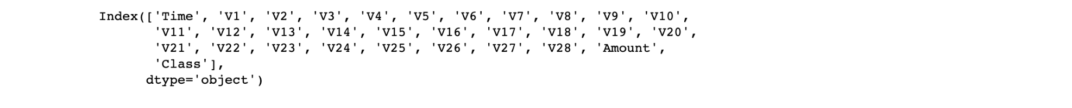
Exploratory data analysis
We have 31 columns, 2 of which are Time and Amount. The rest are output from the PCA transformation

Slide 6
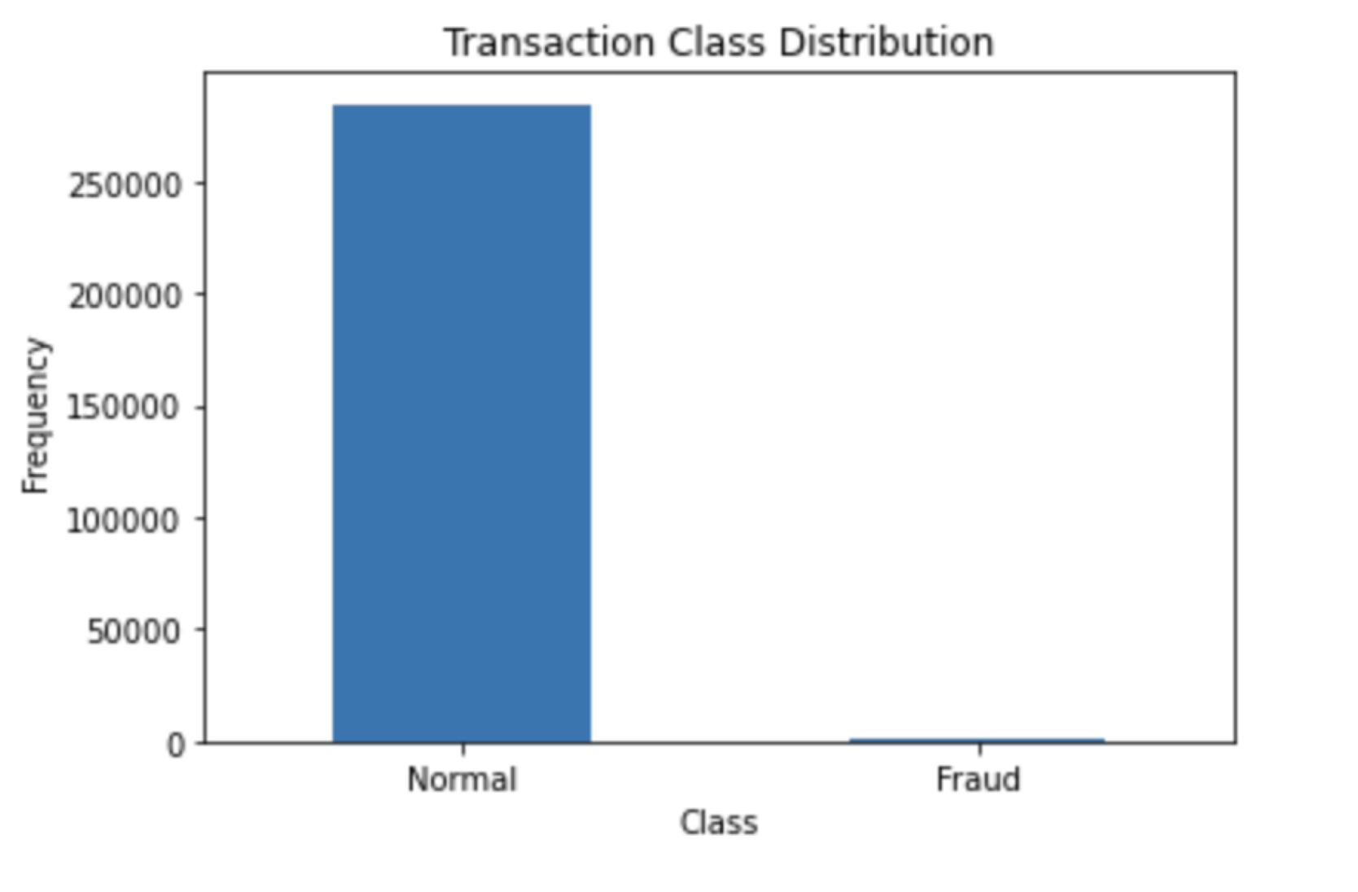
Checking the distribution of the 'Class' column
We have a highly imbalanced dataset on our hands(Only 0.17% transactions are fraudulent whereas 99.8% transactions are normal). Normal transactions overwhelm the fraudulent ones by a large margin.

Slide 7
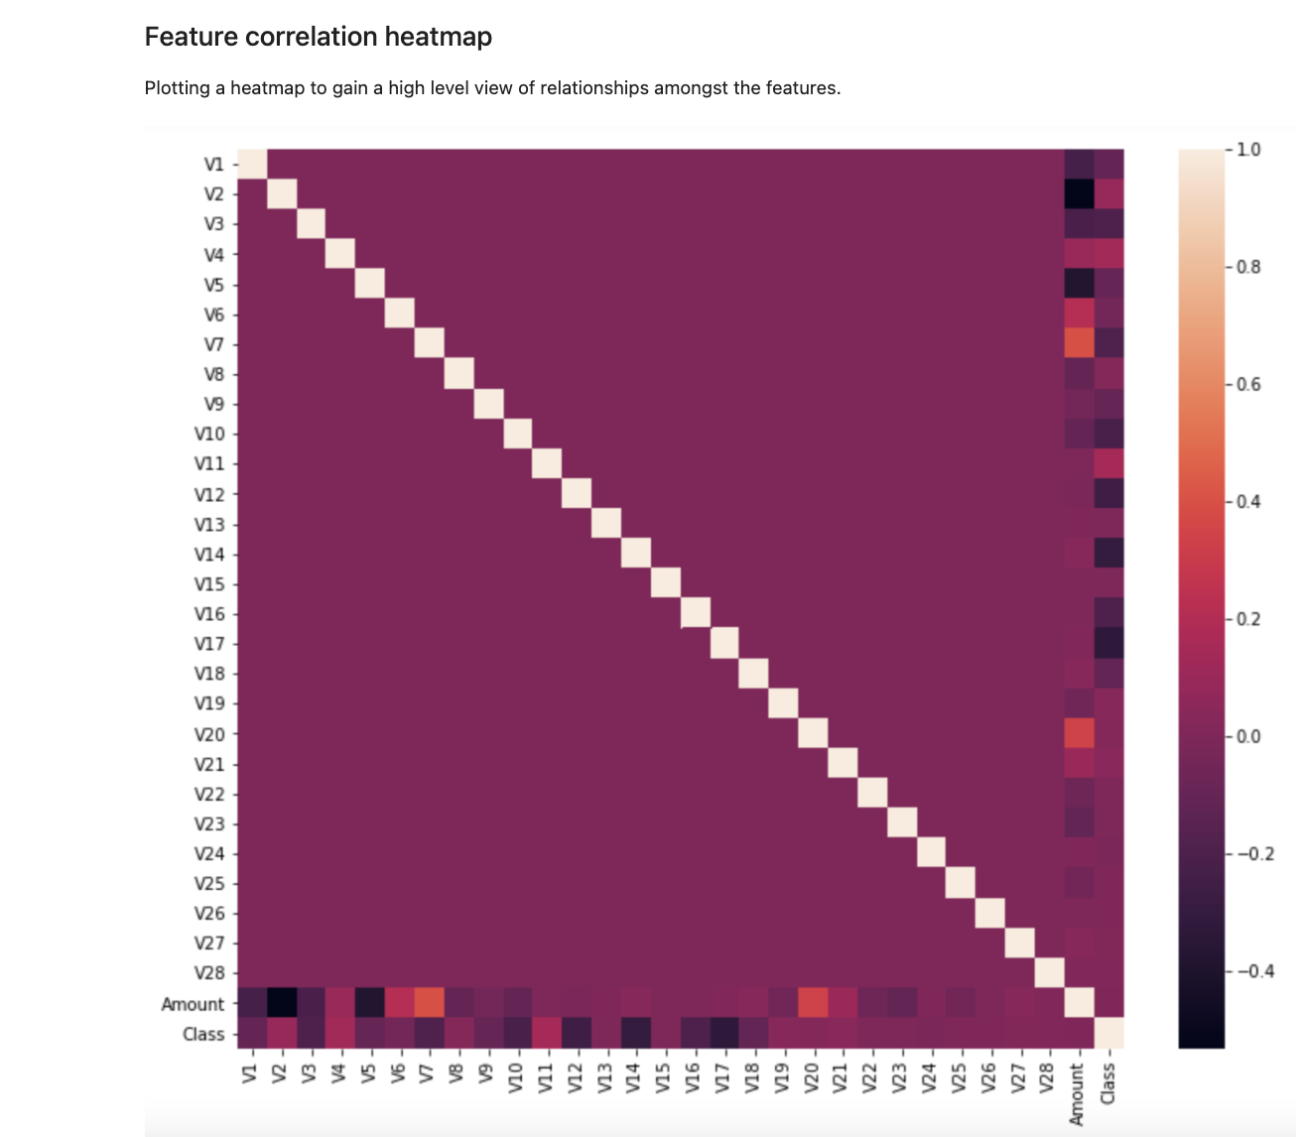
Feature correlation heatmap
The correlation matrix shows that none of the V1 trough V28 PCA components have any correlation to each other however if we observe Class has some form positive and negative correlations with the V components but has no correlation with the Amount.

Slide 8
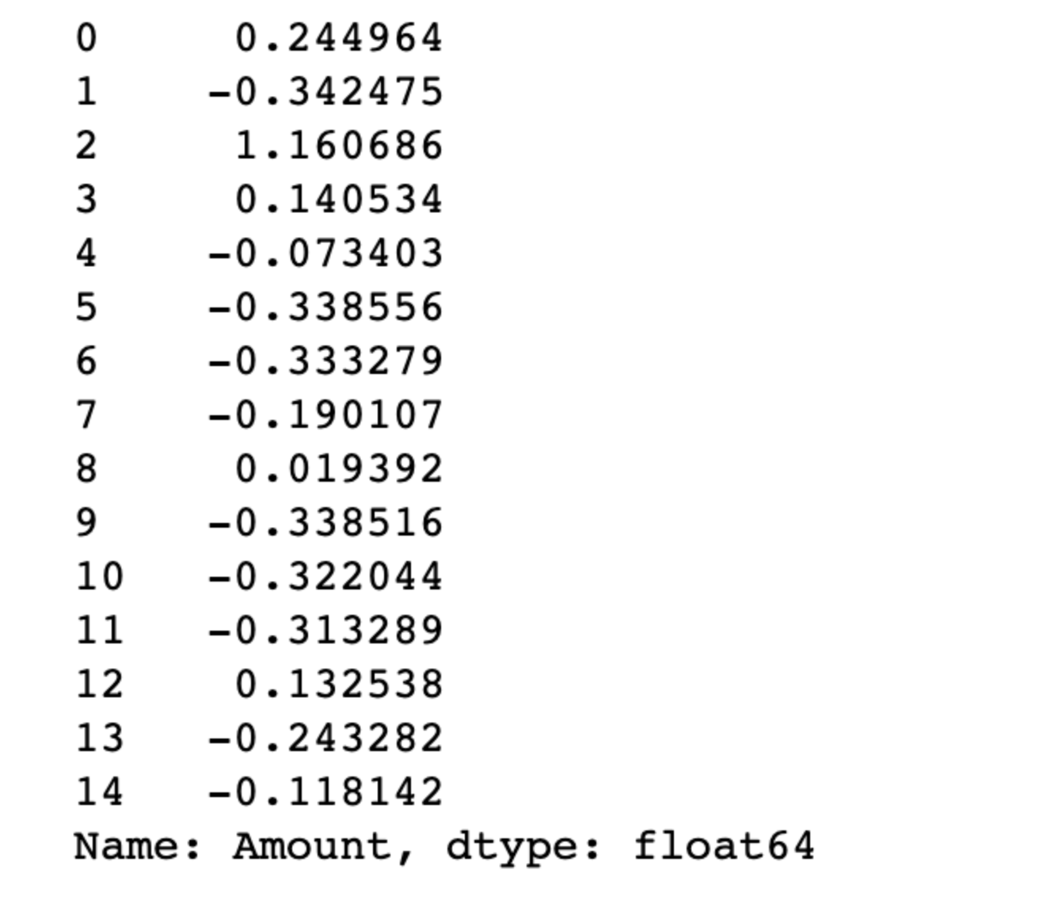
Data Pre-processing
Feature Scaling
We need to scale only the Amount column as all other columns are already scaled by the PCA transformation. I'll use the scikit's StandardScaler on the Amount. The scaler removes the mean and scales the values to unit variance:

Slide 9
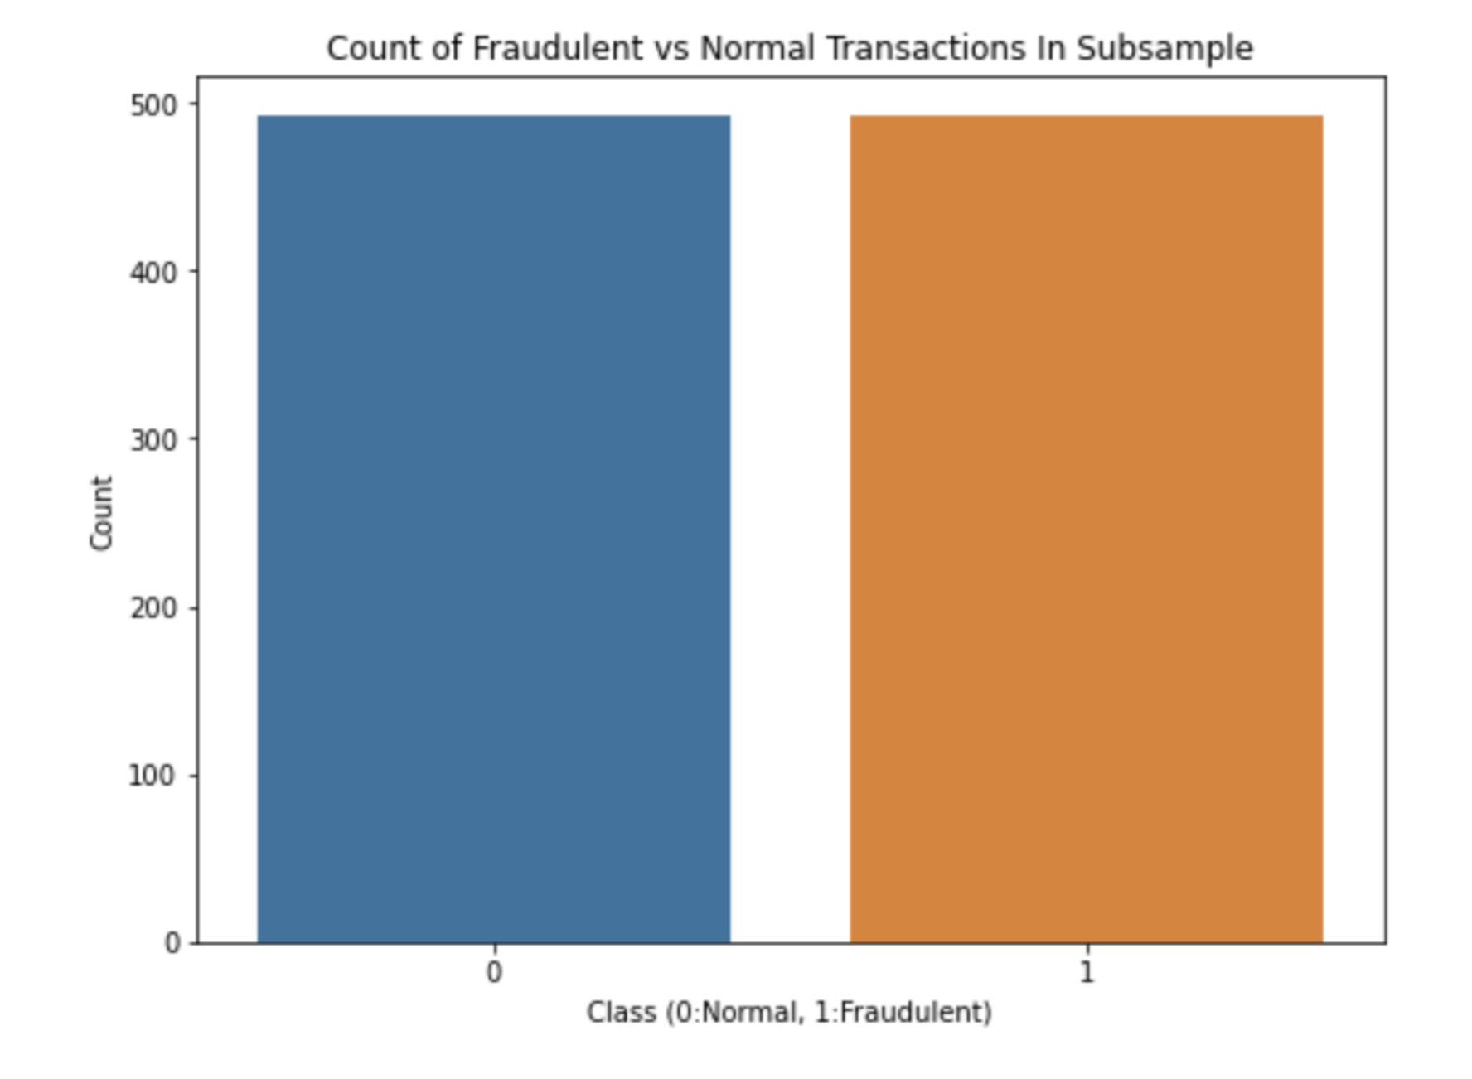
Undersampling
Feature Scaling
We've seen in total dataset we have only 492 fraudlent records, which makes our dataset imbalanced or biased. 99% records are real transaction. Only 1% is fraud. So our data is not balanced. It may result in a model which is biased toward real transaction scenario. So we will apply undersampling and oversampling technique to overcome this conition.

Slide 10
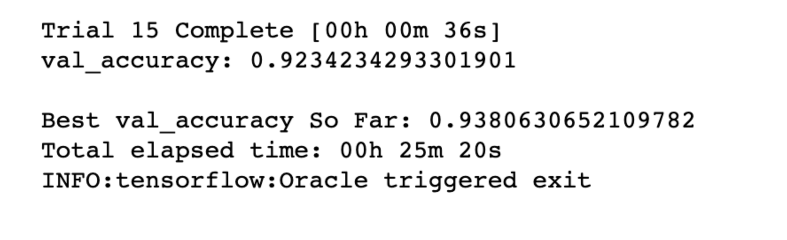
Models Building
1. Artificial Neural Network (ANN)
The ANN takes a vector of length 29 as input. This represents the information related to each transactions, for instance, each line with 29 columns from the dataset. For each transaction, the final layer will output a probability distribution (sigmoid activation function) and classify either as not fraudulent (0) or fraudulent (1).

Slide 11
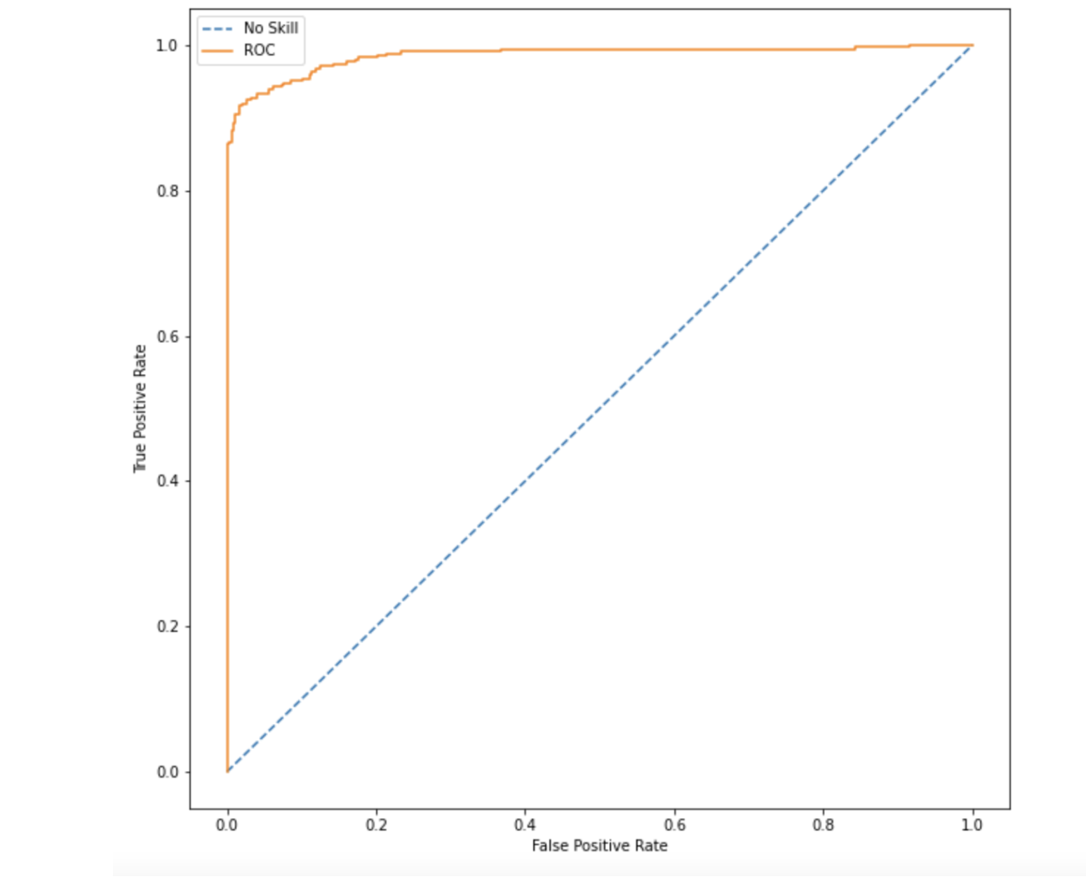
Models Building
2. Logistic Regression
Model Evaluation Summary on train set :
1. F1 Score: 94.1%
2. Class 0 (Non-fraud): Precision: 0.91,
Recall: 0.99, F1-score: 0.95
3. Class 1 (Fraud): Precision: 0.99, Recall: 0.90, F1-score: 0.94
4. Accuracy: 94%
5. Average Scores: Macro and weighted averages for precision, recall, and F1-score are all 0.94

Slide 12
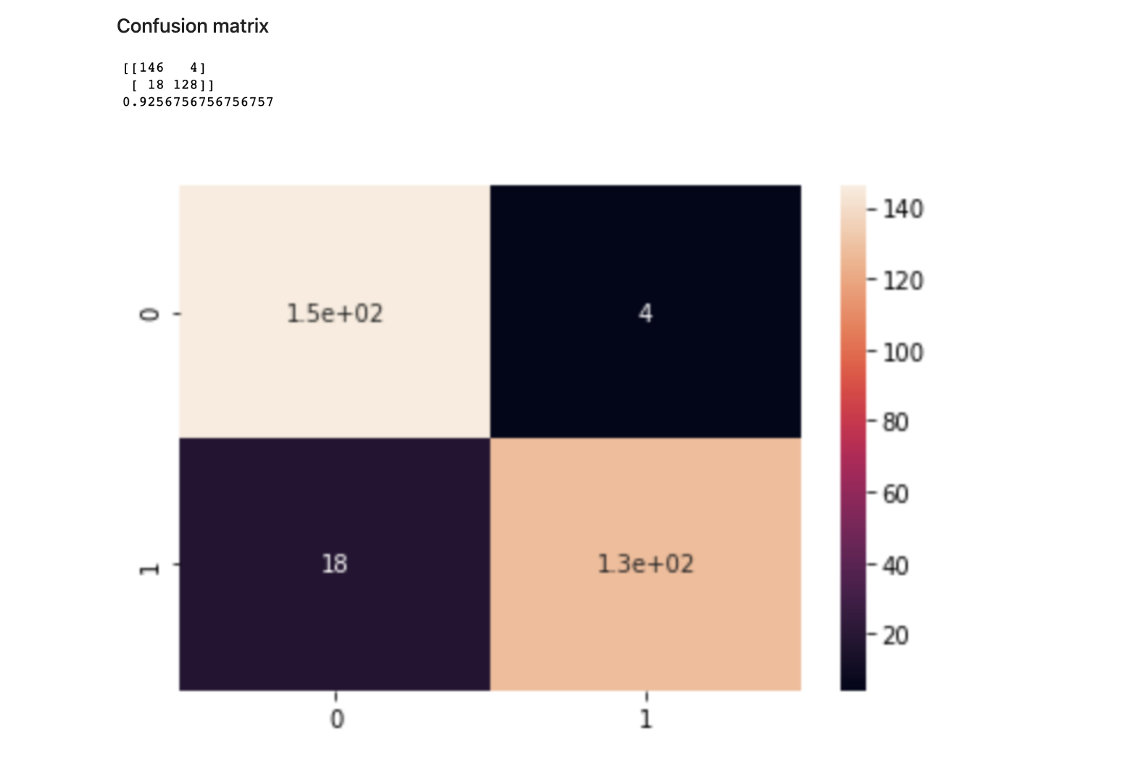
Models Building
2. Logistic Regression
Model Evaluation on Test Set
- F1 Score: 92.09%
- **Class 0 (Non-fraud):** Precision: 0.89, Recall: 0.97, F1-score: 0.93
- **Class 1 (Fraud):** Precision: 0.97, Recall: 0.88, F1-score: 0.92
- **Accuracy:** 93%
- **Average Scores:**
- Macro Average: Precision: 0.93, Recall: 0.93, F1-score: 0.93
- Weighted Average: Precision: 0.93, Recall: 0.93, F1-score: 0.93

Slide 13
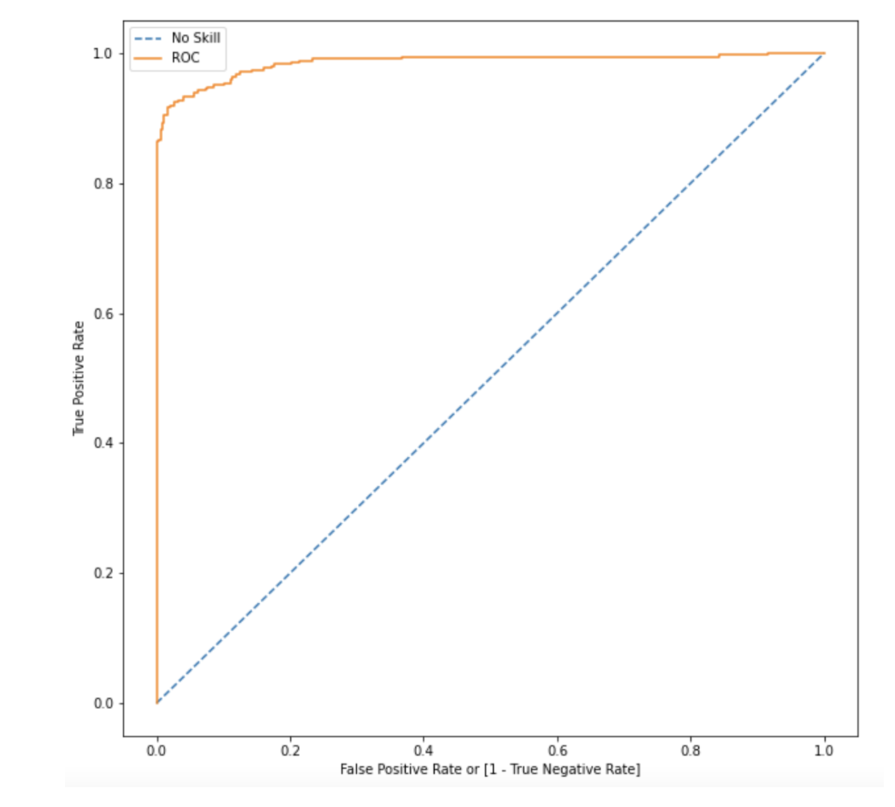
Models Building
3. Decision Tree
Model Evaluation on Train Set
F1 Score: 92.17%
Class 0 (Non-fraud): Precision: 0.89, Recall: 0.96, F1-score: 0.93
Class 1 (Fraud): Precision: 0.96, Recall: 0.88, F1-score: 0.92
Accuracy: 92%
Average Scores:
Macro Average: Precision: 0.93, Recall: 0.92, F1-score: 0.92
Weighted Average: Precision: 0.93, Recall: 0.92, F1-score: 0.92

Slide 14
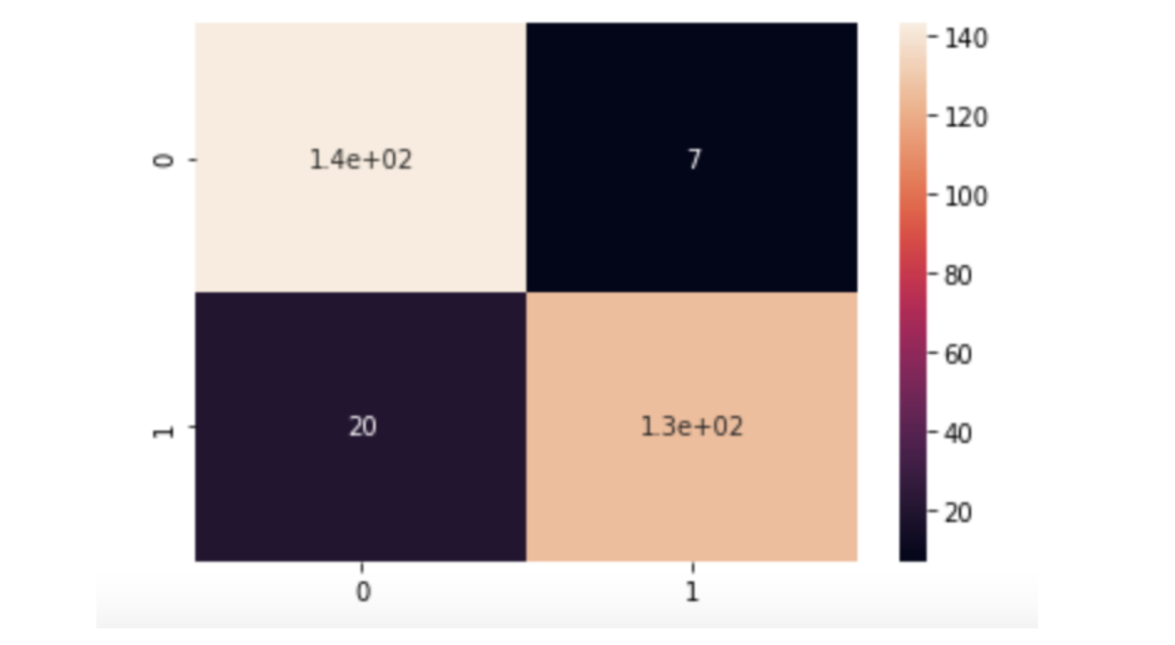
Models Building
3. Decision Tree
Model Evaluation on Test Set
-F1 Score: 90.32%
Class 0 (Non-fraud): Precision: 0.88, Recall: 0.95, F1-score: 0.91
Class 1 (Fraud): Precision: 0.95, Recall: 0.86, F1-score: 0.90
Accuracy: 91%
Average Scores:
Macro Average: Precision: 0.91, Recall: 0.91, F1-score: 0.91
Weighted Average: Precision: 0.91, Recall: 0.91, F1-score: 0.91

Slide 15
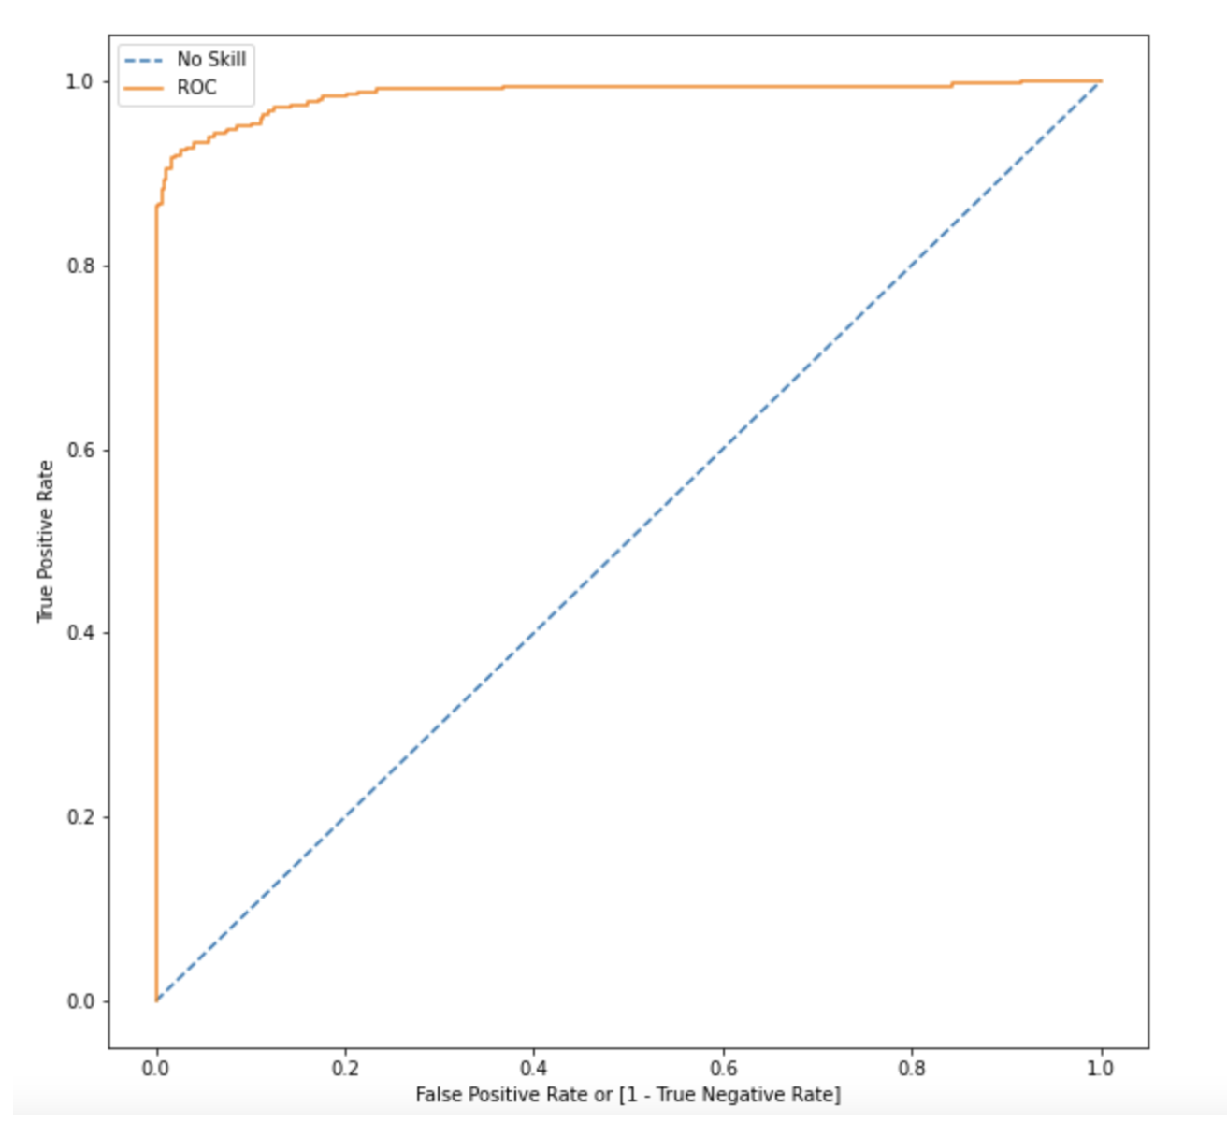
Models Building
4. Random Forest
Model Evaluation on Train Set
F1 Score: 94.86%
Class 0 (Non-fraud): Precision: 0.91, Recall: 0.99, F1-score: 0.95
Class 1 (Fraud): Precision: 0.99, Recall: 0.91, F1-score: 0.95
Accuracy: 95%
Average Scores:
Macro Average: Precision: 0.95, Recall: 0.95, F1-score: 0.95
Weighted Average: Precision: 0.95, Recall: 0.95, F1-score: 0.95

Slide 16
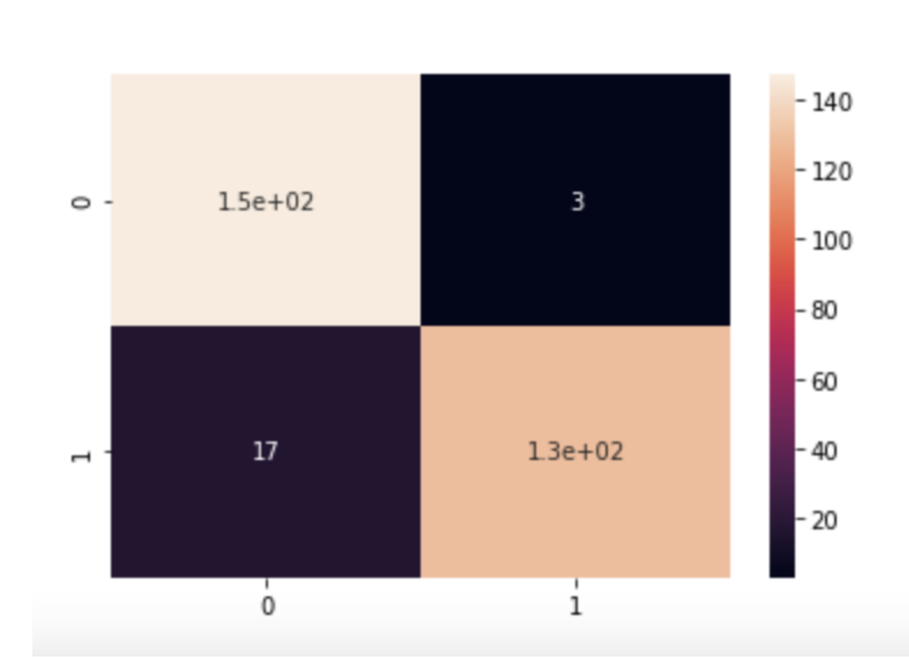
Models Building
4. Random Forest
Model Evaluation on Test Set
F1 Score: 92.81%
Class 0 (Non-fraud): Precision: 0.90, Recall: 0.98, F1-score: 0.94
Class 1 (Fraud): Precision: 0.98, Recall: 0.88, F1-score: 0.93
Accuracy: 93%
Average Scores:
Macro Average: Precision: 0.94, Recall: 0.93, F1-score: 0.93
Weighted Average: Precision: 0.94, Recall: 0.93, F1-score: 0.93

Slide 17
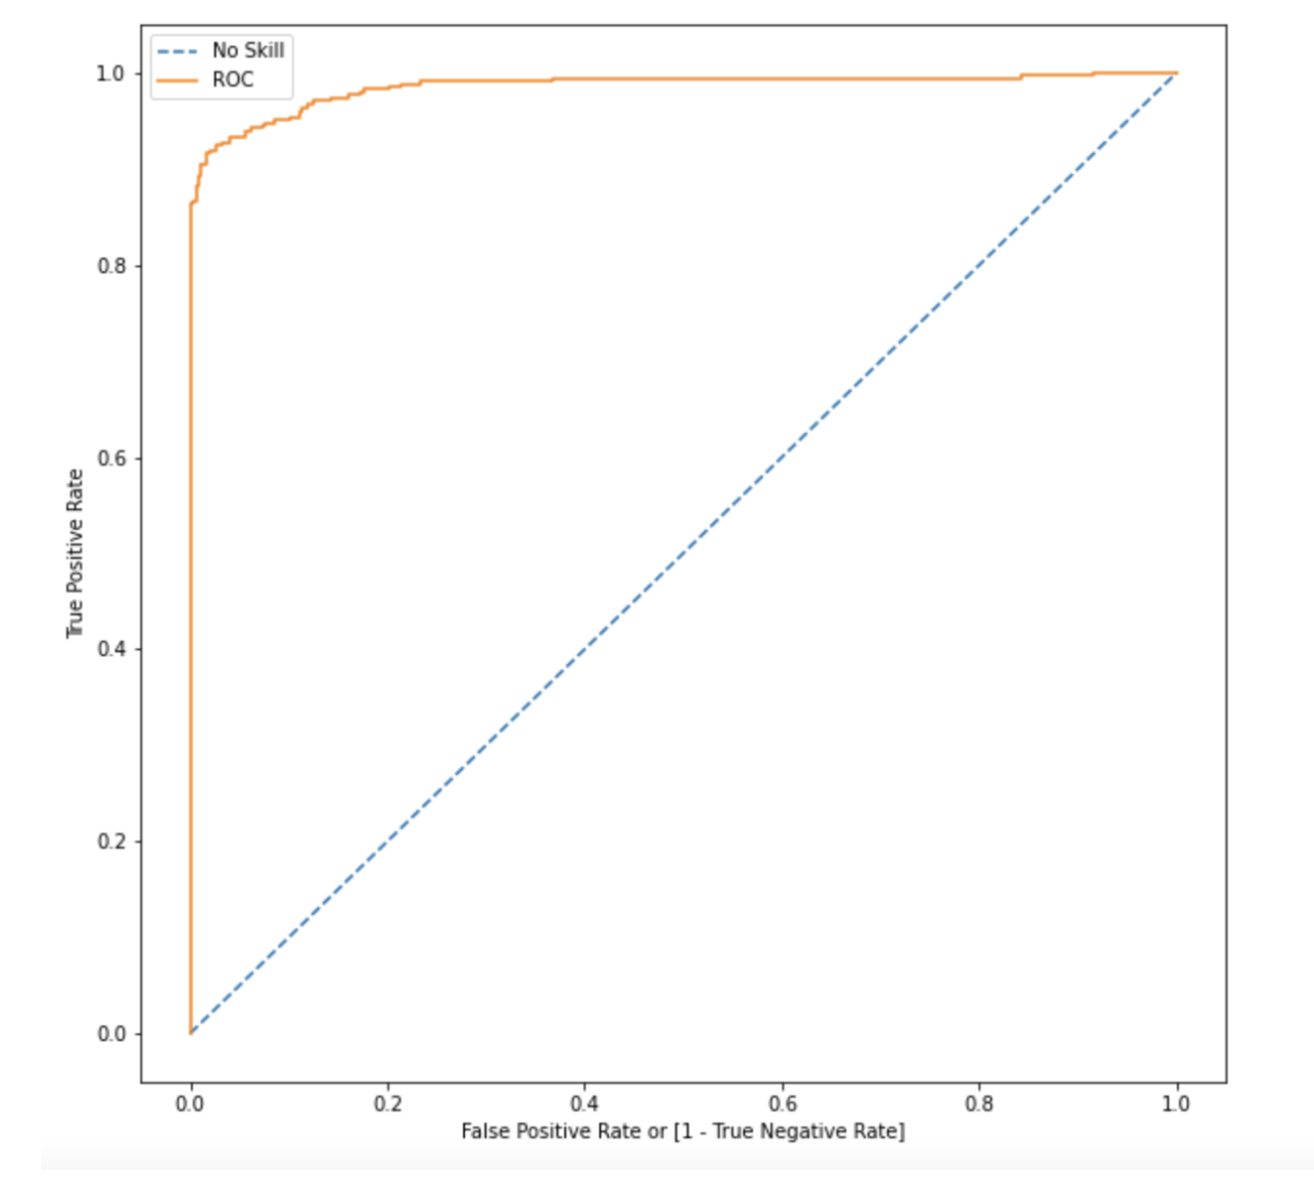
Models Building
5. XGBoost
Model Evaluation on Train Set
F1 Score: 100.0%
Class 0 (Non-fraud): Precision: 1.00, Recall: 1.00, F1-score: 1.00
Class 1 (Fraud): Precision: 1.00, Recall: 1.00, F1-score: 1.00
Accuracy: 100%
Average Scores:
Macro Average: Precision: 1.00, Recall: 1.00, F1-score: 1.00
Weighted Average: Precision: 1.00, Recall: 1.00, F1-score: 1.00

Slide 18
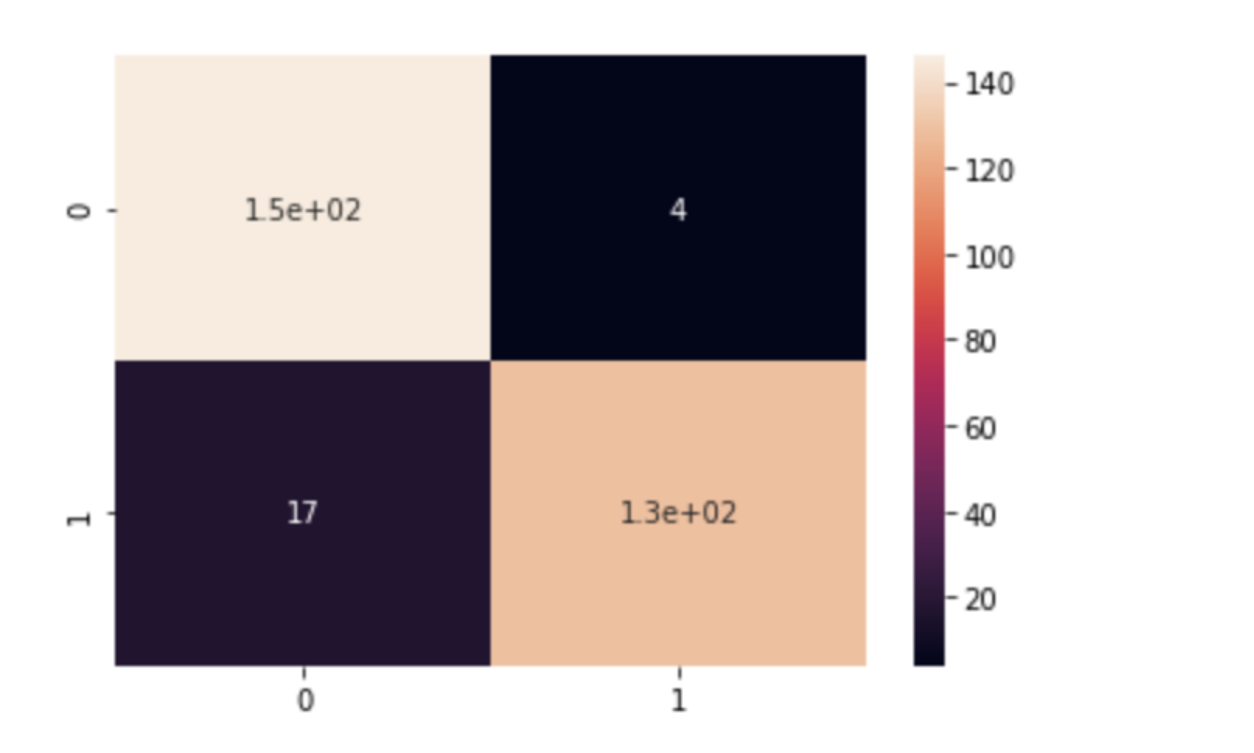
Models Building
5. XGBoost
Model Evaluation on Test Set
F1 Score: 92.47%
Class 0 (Non-fraud): Precision: 0.90, Recall: 0.97, F1-score: 0.93
Class 1 (Fraud): Precision: 0.97, Recall: 0.88, F1-score: 0.92
Accuracy: 93%
Average Scores:
Macro Average: Precision: 0.93, Recall: 0.93, F1-score: 0.93
Weighted Average: Precision: 0.93, Recall: 0.93, F1-score: 0.93

Slide 19


Conclusion
Model Performance:
Most models perform well in terms of ROC score, Recall, and Precision.
Considerations for Best Model:
Infrastructure, resources, and computational power required.
High-complexity models (ANN, Random Forest, XGBoost) need more resources and higher deployment costs.
Simpler models (Logistic Regression) need fewer resources and lower costs.

Slide 20


Conclusion
Cost vs. Performance:
Consider the monetary impact of ROC score changes.
Balance between cost of building the model and the potential monetary gain or loss.
Recommendation:
XGBoost performs well on balanced datasets with undersampling.
High ROC score and Recall.
Easy to interpret and explain to the business.

